Slide 1


Cambridge Checkpoint
Part of Cambridge University, UK
Not for profit department of the Uni.

Slide 2



old
current
new from 2024

Slide 3
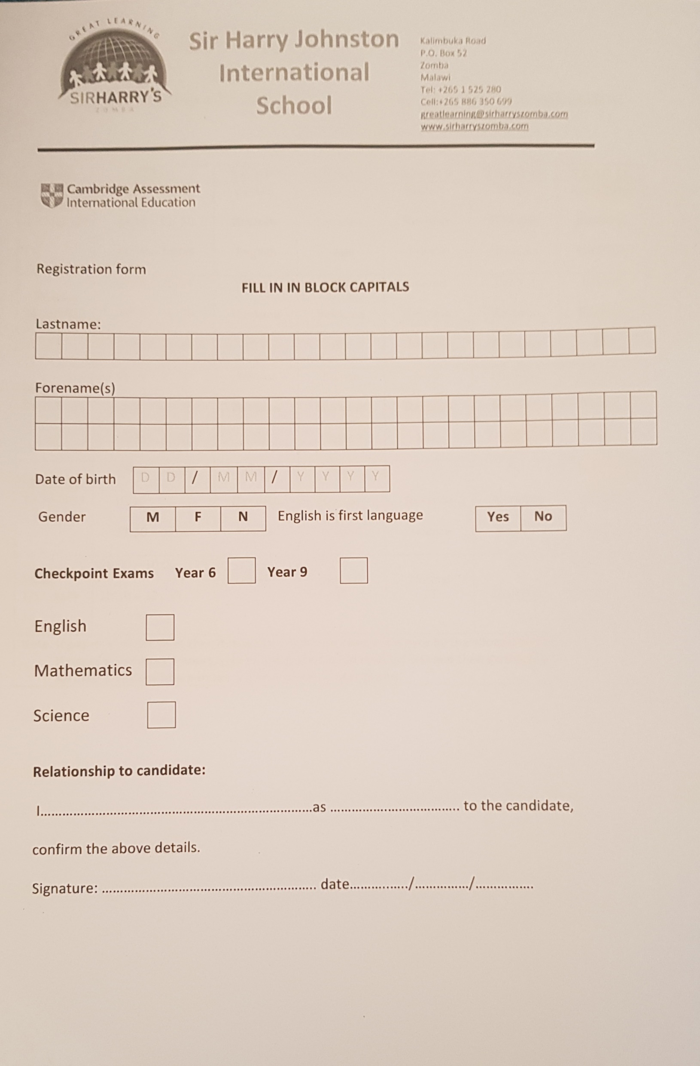
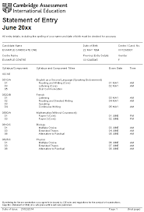

Slide 4
Y6 |  | Y9
English | Paper 1 1hr 50 marks Paper 2 1hr 50marks | English | Paper 1 1hr 10 50 marks Paper 2 1hr 10 50 marks
Maths *no calculator | Paper 1* 45m 40 marks Paper 2 45m 40 marks | Maths | Paper 1* 1hr 50 marks Paper 2 1hr 50 marks
Science | Paper 1 35m 40 marks Paper 2 35m 40marks | Science | Paper 1 45m 50 marks Paper 2 45m 50marks

Slide 5
Day of the exams
Window of exam dates: 10-28th April
Typically
TUE: English p1 & p2
WED: Mathematics p1 & p2
THU: Science p1 & p2
Exams are then sealed in the exam room, and sent to UK for marking.

Slide 6
PRIMARY CHECKPOINT: MK 65,200 per subject
SECONDARY CHECKPOINT: MK 88,500 per subject
We can start collecting now and these can be paid in instalments.
Result cannot be issued until all fees (exam & school) have been cleared.

Slide 7
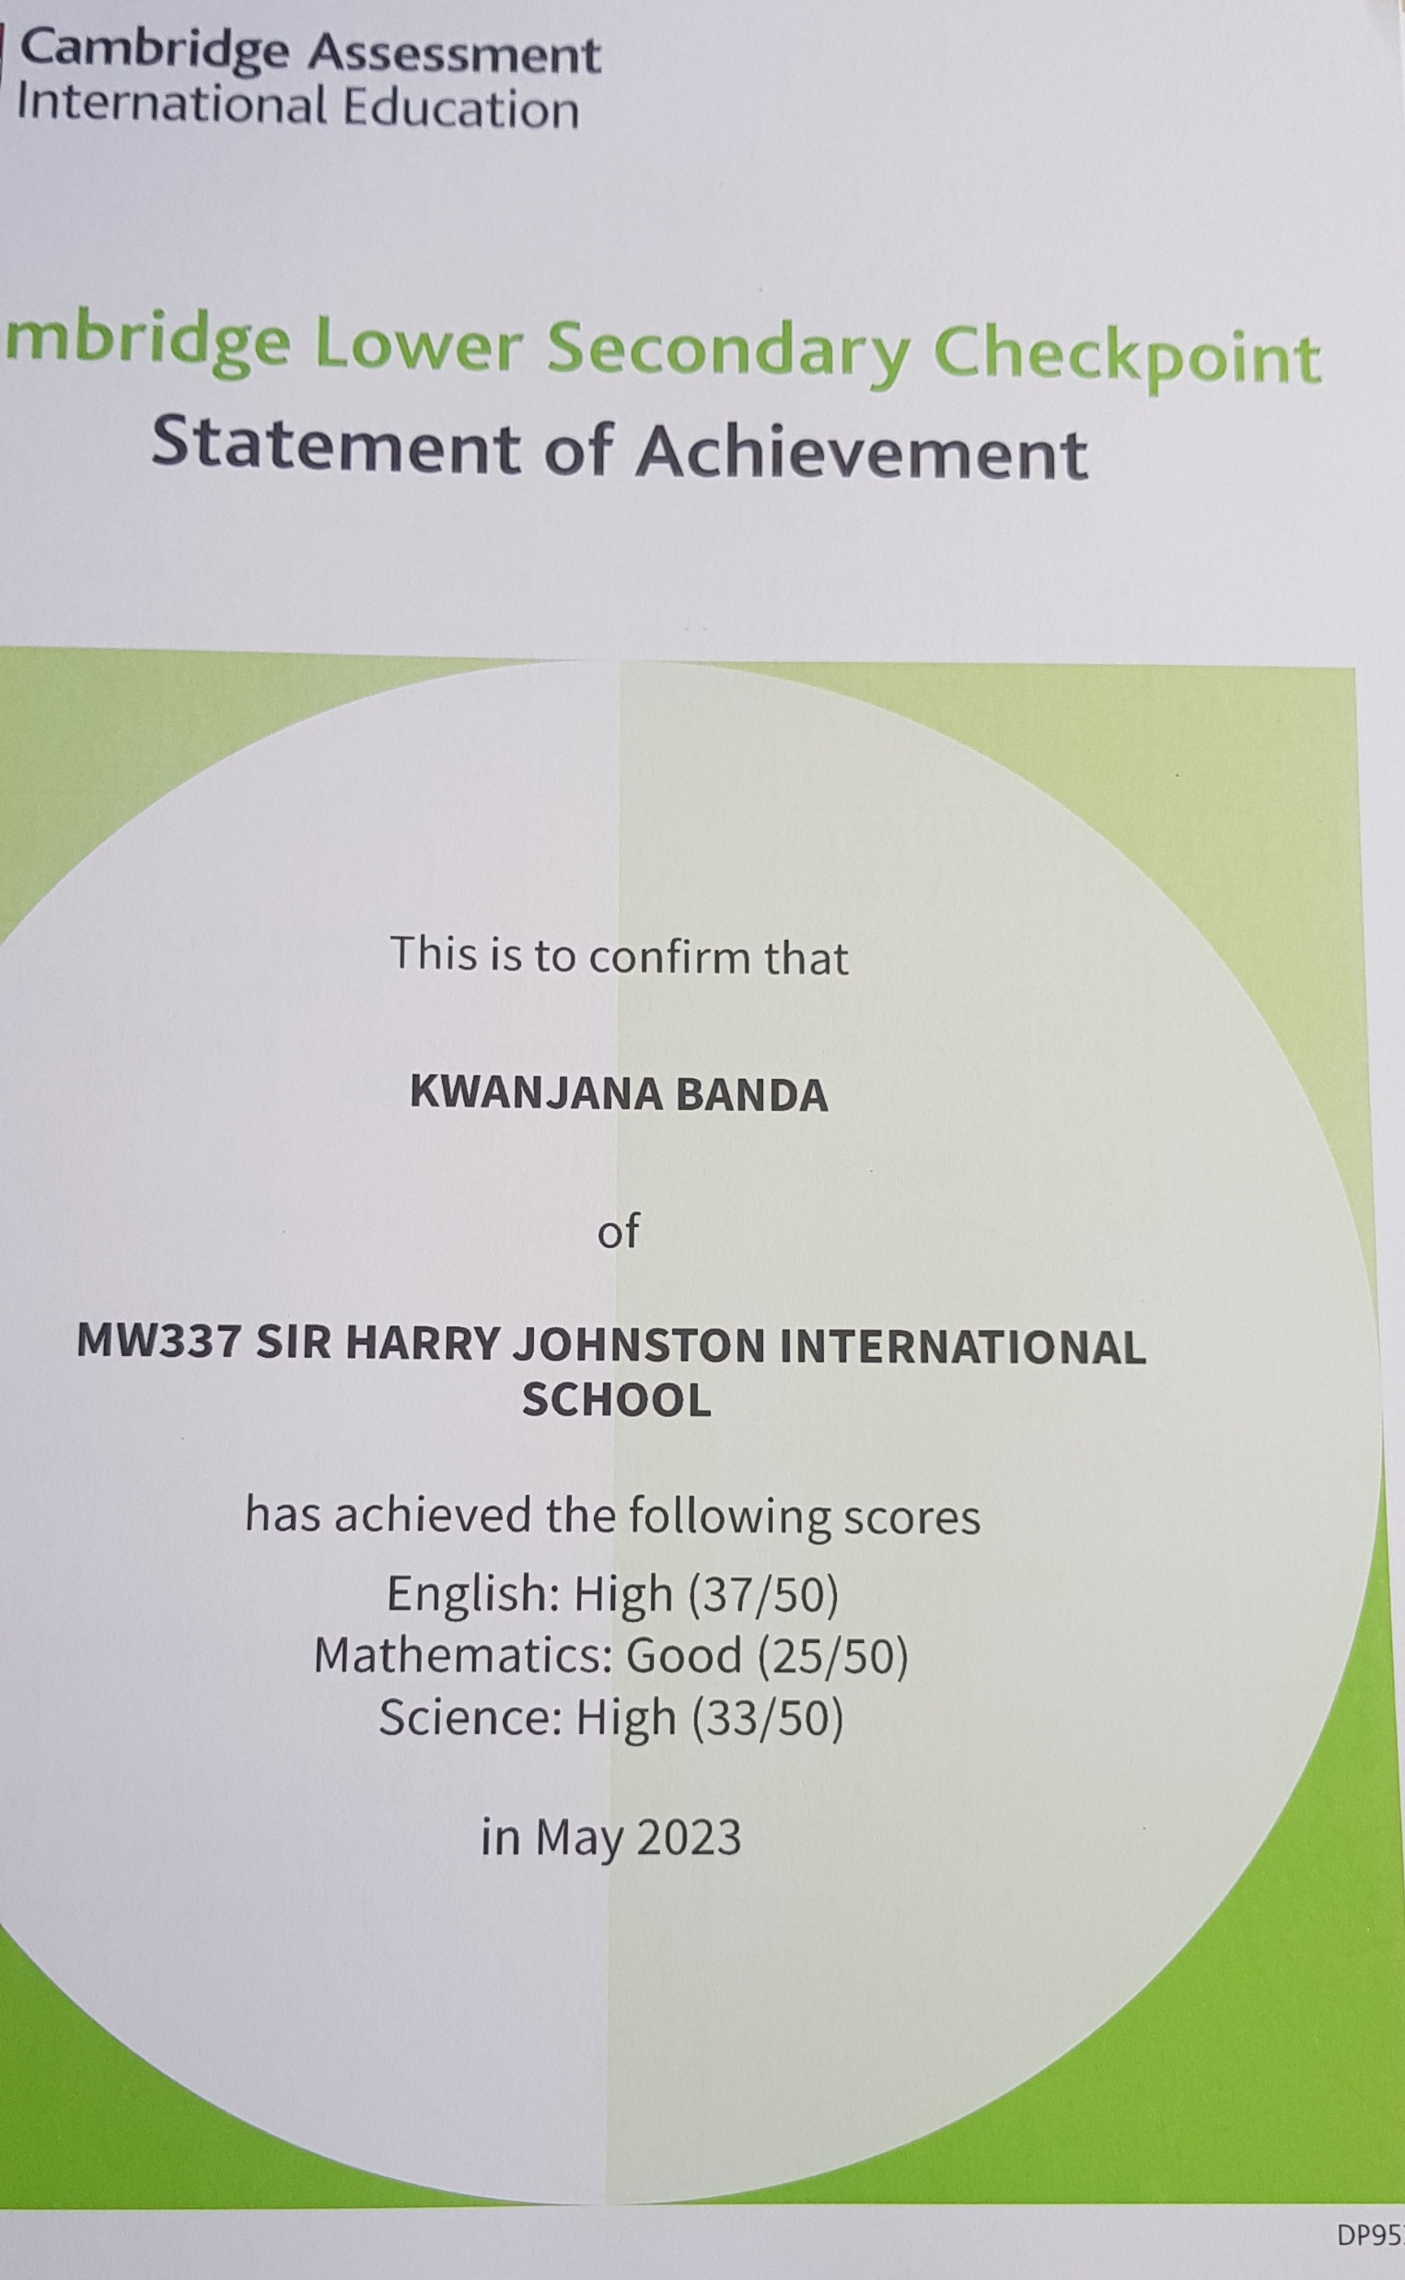
Gradings
Outstanding
High
Good
Aspiring
Basic

Slide 8
Cambridge for parents/students
Revision websites:
BBC bitesize is a good place to start.
https://znotes.org/caie/checkpoint/
Y6: KS2
Y9: KS3
https://www.cambridgeinternational.org/why-choose-us/parents-and-students/

